Slide 1
Quay Bank Analysis
Using SQL Server Management Studio

Slide 2
Performance Analysis
This analysis explores four key areas of banking operations: branch performance, call center operations, customer feedback, and the handling of customer complaints.
By using SQL queries to examine various aspects like unresolved complaints, how long calls take and how they're resolved, positive feedback from customers, and complaints about account management, we get a clear picture of what's working well and what isn't.
The data reveals significant insights into operational strengths and weaknesses, customer service effectiveness, and potential areas for improvement.

Slide 3
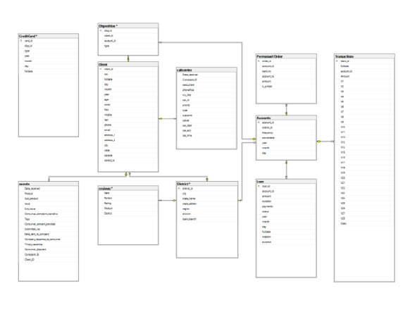

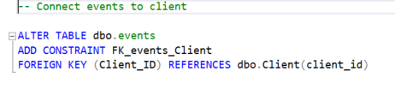

Schema
Connect tables to Schema

Slide 4
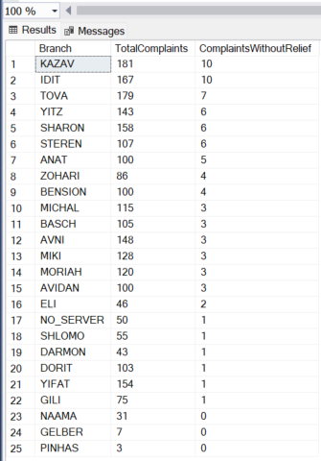
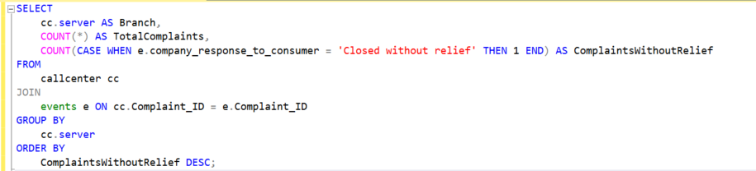
Performance
This query is retrieving information from the call center about the number of complaints received and how many of those were closed without relief.
The data is sorted to list those branches with the highest number of complaints closed without relief are at the top. The branch named KAZAV appears to have the highest number of such complaints (10), followed by IDIT with 167 total complaints.

Slide 5
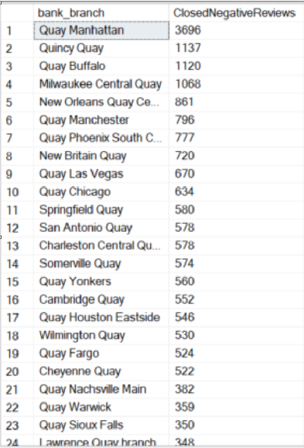
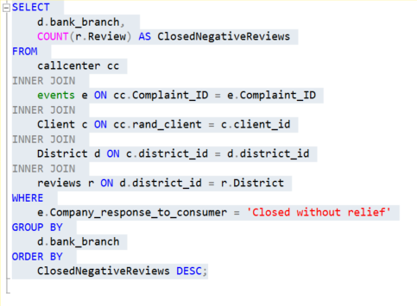
Negative Reviews by Branch
The SQL query is designed to report on customer satisfaction across different branches of a bank by counting the instances of reviews marked as 'Closed without relief'. It does this by aggregating data from multiple related tables in the database.
This query serves by identifying branches with higher numbers of unsatisfactorily closed reviews, which may indicate a problem with how customer complaints are being handled at those branches.
The results show that the branch 'Quay Manhattan' has the highest number of negative reviews (3696), followed by 'Quincy Quay' with 1137, and so on. These figures represent the instances where complaints were marked as 'Closed without relief' per branch, sorted from the most to the least occurrences. It highlights which branches might require closer scrutiny and potential improvements in customer service and complaint resolution processes.

Slide 6
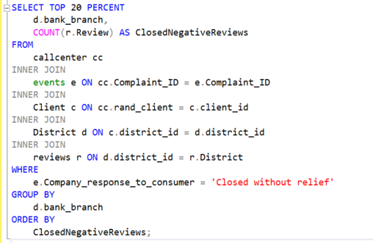
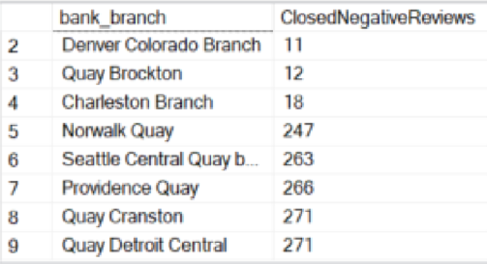
Top 20% Branches with Closed Negative Reviews
This SQL query selects a portion of the data from a bank’s database related to customer complaints. Specifically, it's structured to return branches with the most complaints marked as 'Closed without relief'.
The result set shows the top 20% of bank branches with the highest number of 'Closed without relief' reviews. For instance, 'Quay Detroit Central' has the most negative reviews with 271, followed by 'Quay Cranston' with 271, down to 'Denver Colorado Branch' with 11.

Slide 7
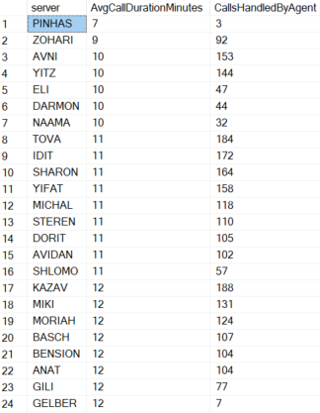
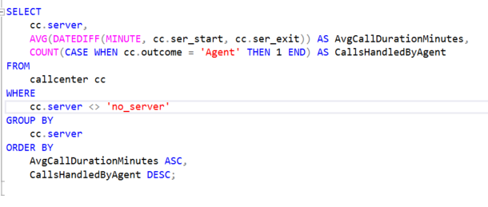
Rank call center servers performance according to call duration and outcome
The SQL query is extracting data on call durations and the number of calls handled by agents from a call centre database.
The results are ordered showing the servers with the shortest average call durations come first, and within those, the servers that handled the most calls are shown first.
In the results, you can see a list of servers with their corresponding average call duration and the number of calls they handled. For example, the server 'PINHAS' has an average call duration of 7 minutes and has handled 3 calls.

Slide 8
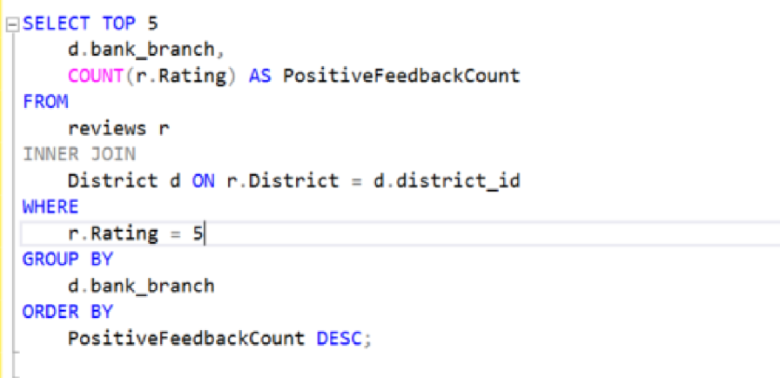
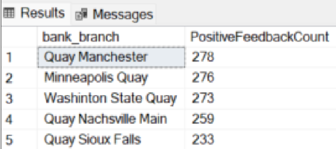
List top 5 branches per positive customer feedback
The SQL query is designed to identify the top 5 bank branches with the most positive customer feedback based on the ratings in reviews. The result set shows the bank branches in descending order of the number of positive reviews they have received:
Quay Manchester: 278 positive reviews.
Minneapolis Quay: 276 positive reviews.
Washington State Quay: 273 positive reviews.
Quay Nashville Main: 259 positive reviews.
Quay Sioux Falls: 253 positive reviews.

Slide 9
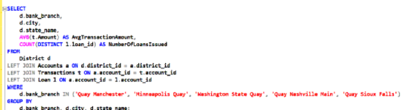
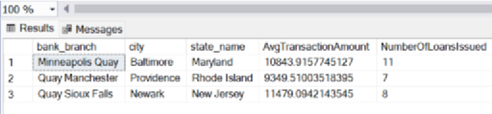
List top 5 branches characteristics
The SQL query is structured to retrieve data on the top branches. The results indicate:
Minneapolis Quay in Baltimore, Maryland has an average transaction amount of $10843.92 and has issued 11 loans.
Quay Manchester in Providence, Rhode Island has an average transaction amount of $9349.51 and has issued 7 loans.
Quay Sioux Falls in Newark, New Jersey has an average transaction amount of $11479.09 and has issued 8 loans.
The data gives an insight into the operational metrics of the branches, including how much money is typically moved in transactions and how many loans are issued. This could reflect the activity level, the customer wealth profile, or the loan product popularity of each branch.
The result only lists 3 branches which indicates that there might be a problem with the schema and how it was connected.

Slide 10
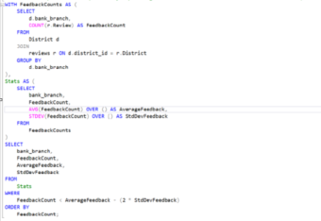
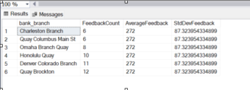
Reporting CRM Data: How well are branches and customer service staff handling customer complaints
The SQL query is a multi-part query that uses Common Table Expressions (CTEs) to calculate the average feedback and its standard deviation for bank branches based on the count of feedback entries.
This filter clause selects bank branches whose feedback count is less than the average minus two times the standard deviation. Essentially, it filters for branches that have significantly fewer feedbacks than average, potentially identifying branches with notably low feedback counts.
The results suggest that each listed branch has a feedback count that is less than the average minus two standard deviations. All branches show the same average and standard deviation values, meaning these statistics were calculated over the entire dataset.
Since the results are uniform in AverageFeedback and StdDevFeedback, it seems there could be an error in the query or the underlying data that causes these statistics to be the same for all branches, which is somewhat unusual. Normally, you'd expect some variation in average and standard deviation between different branches unless the data set is very uniform.

Slide 11
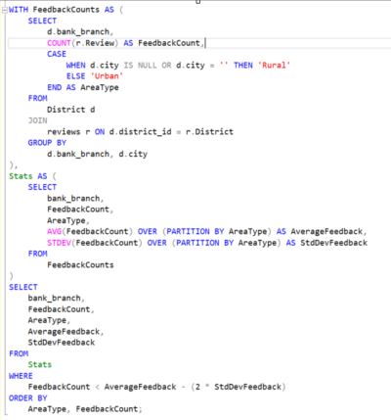

Separating branches in urban from those in rural areas
The result set indicates that all the branches listed are classified as 'Urban', and they all share the same average feedback count and standard deviation. This could mean that:
There were no 'Rural' branches in the top part of the dataset or that they didn't meet the WHERE clause condition.
All 'Urban' branches had a feedback count that was less than their calculated average minus twice the standard deviation, which seems odd as they all have the same average and standard deviation. This could indicate an anomaly in the data or that the condition for the WHERE clause is not discriminating enough to provide meaningful differentiation between branches.
From the results shown, it seems unlikely that all the branches would have the exact same average and standard deviation unless the feedback counts for all urban branches in the dataset were extremely uniform. It could also be that there's an error in the way the window functions were used, but that would require further investigation with access to the database.

Slide 12
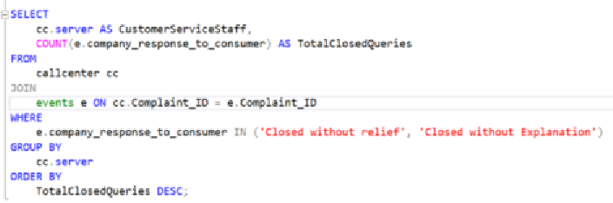
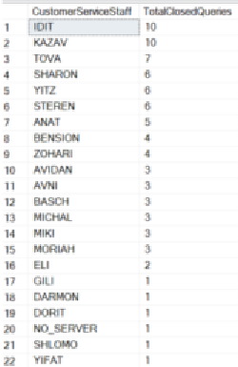
Customer Complaints
The SQL query retrieves a list of customer service staff members and the number of complaints that were closed without relief or explanation. It sorts the staff members in descending order of these closed queries, effectively ranking them by the number of unresolved complaints handled. The accompanying result set shows each staff member’s identifier along with their corresponding total of such complaints, with the highest numbers at the top.

Slide 13
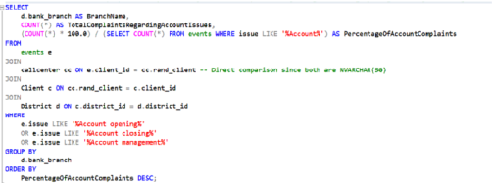
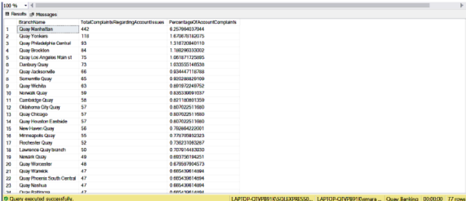
Which branches are proportionally receiving the most complaints regarding 'Account opening, closing, or management'?
The SQL query is designed to report on complaints related to account issues at various bank branches. It counts the total number of such complaints and calculates what percentage they represent of all account-related complaints in the system.
From the results, it appears that Quay Manhattan has the highest number of complaints related to account issues (442), which is 6.257% of all such complaints in the system, suggesting it may have a specific issue with account management processes. Other branches follow in descending order by this metric.
The percentage column provides insight into the relative scale of the problem at each branch. A higher percentage indicates a larger share of the overall account-related complaints, which could be due to various factors such as high customer volume, process inefficiencies, or other local issues.

Slide 14
Conclusions and recommendations:
Underperforming Branches: Analysis highlights branches like KAZAV, 'Quay Manhattan', and 'Quincy Quay' struggling with complaint resolution. KAZAV, notably, closed 10 complaints without relief, indicating a deeper issue than just high complaint volumes.
Call Centre Performance: Examination of call centre servers like 'PINHAS', who averaged 7-minute calls, shows efficient service. However, wide variations in service delivery suggest a need for standardized procedures to ensure consistent customer experiences.
Customer Satisfaction Leaders: Branches such as 'Quay Manchester' and 'Minneapolis Quay', receiving high positive feedback, demonstrate successful customer engagement and service strategies, making them models for others.
Complaint Management: A widespread issue with unresolved complaints across many branches signals the need for a comprehensive review and improvement of the complaint management process, including better training and possibly revising the bank's approach to customer service.
To improve the bank's service, it's recommended to closely examine and fix the issues causing customer complaints, especially in branches like KAZAV and 'Quay Manhattan'. By learning from the best practices of branches that receive a lot of positive feedback, like 'Quay Manchester', and making sure all call center staff follow a clear set of guidelines, the bank can offer more consistent and satisfying customer service. This plan should include better training for employees and a thorough look at how complaints are handled to make sure customers feel heard and valued.

